Slide 1
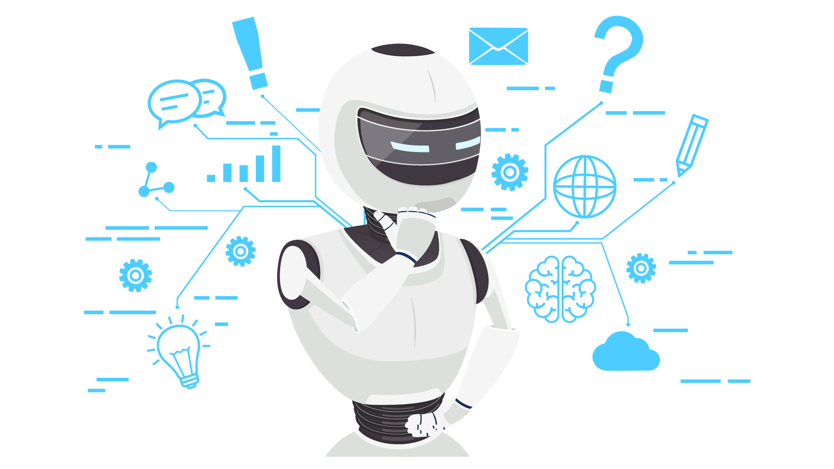
A Date with AI! Deepak Mishra

Slide 2
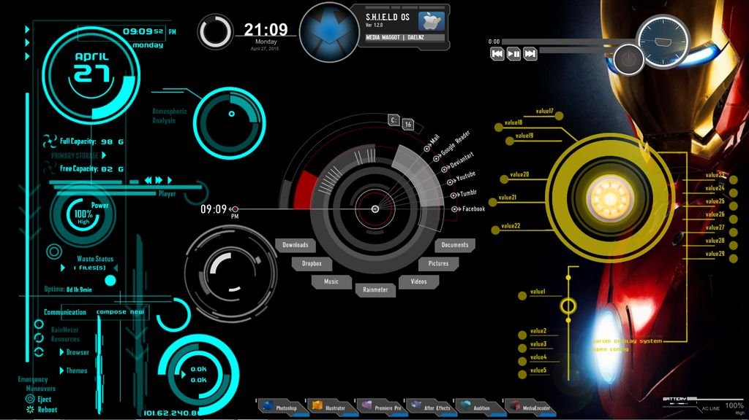
Artificial General Intelligence
aka Jarvis
10:00 What is Artificial Intelligence
Demystifying AI terminology
History of AI
AI Boom
20:00 How AI works
ABC of AI
Why AI works
10:00 How to Augment our intelligence about AI
What to Learn
How to Learn
Tools required
A Date with AI

Slide 3
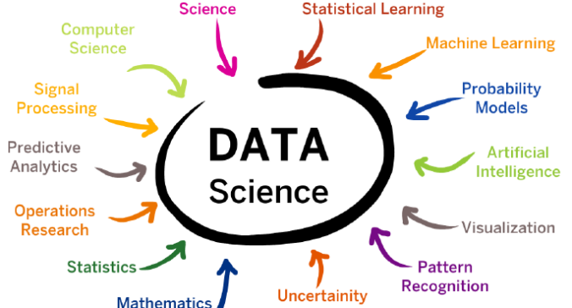
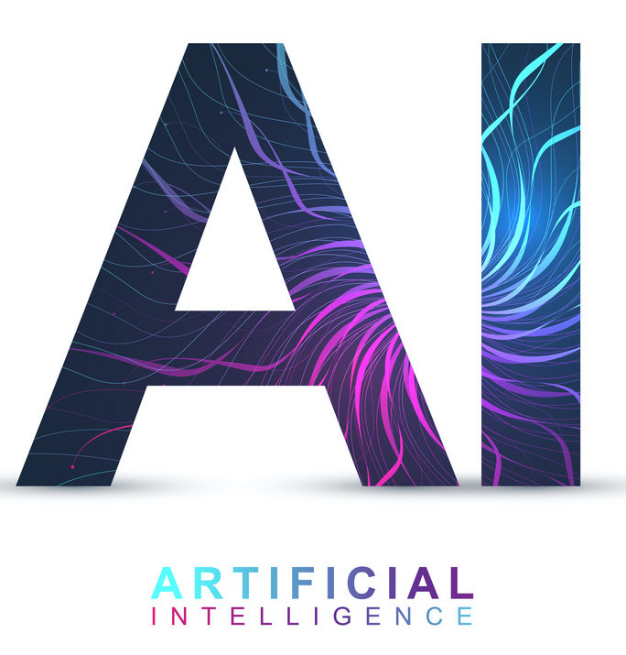
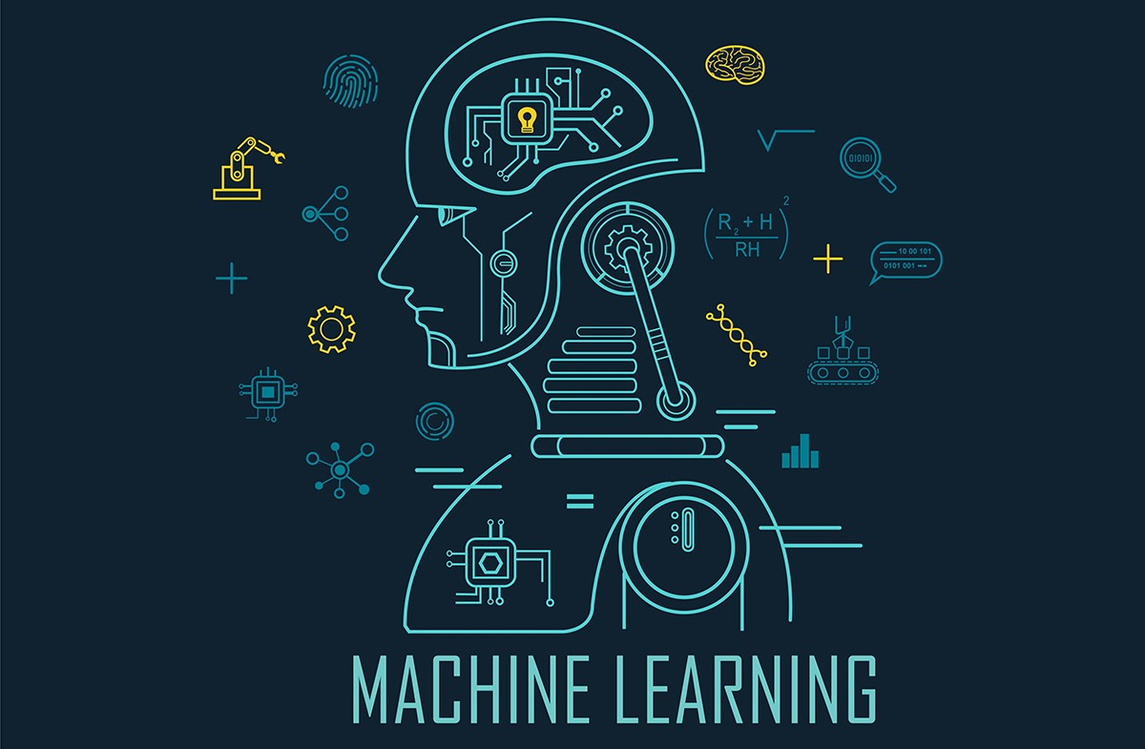
What is AI/ML/DS
Artificial intelligence is the simulation of human intelligence processes by machines
Machine learning is an application of artificial intelligence (AI) that focuses on the development of computer programs that can access data and use it learn for themselves
Data science is the field of study that combines domain expertise, programming skills, and knowledge of machine learning algorithms to generate insights from data like text, images, video, audio etc.

Slide 4
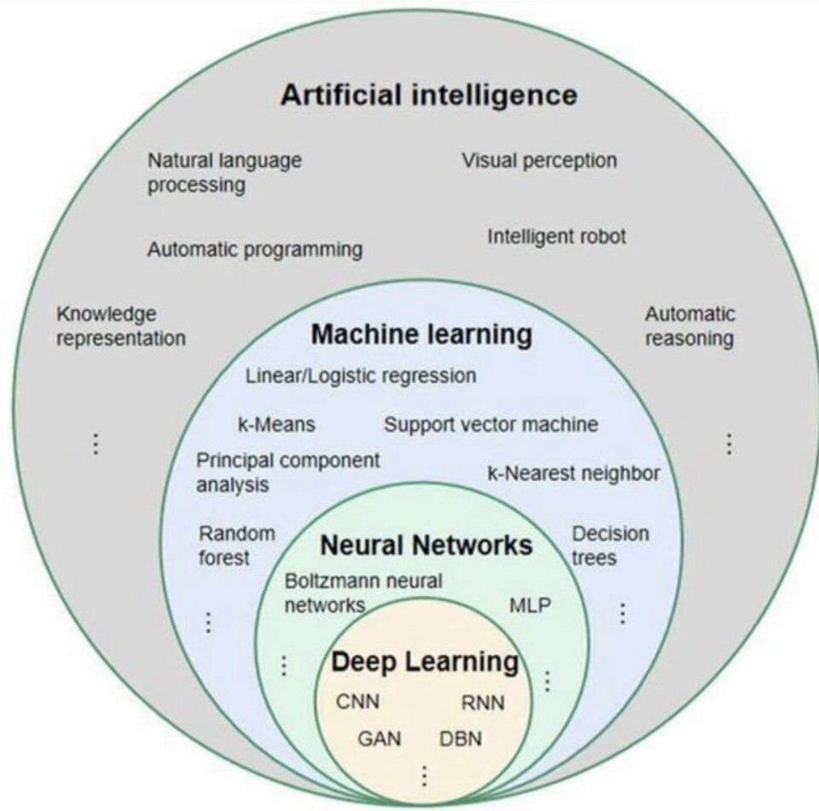
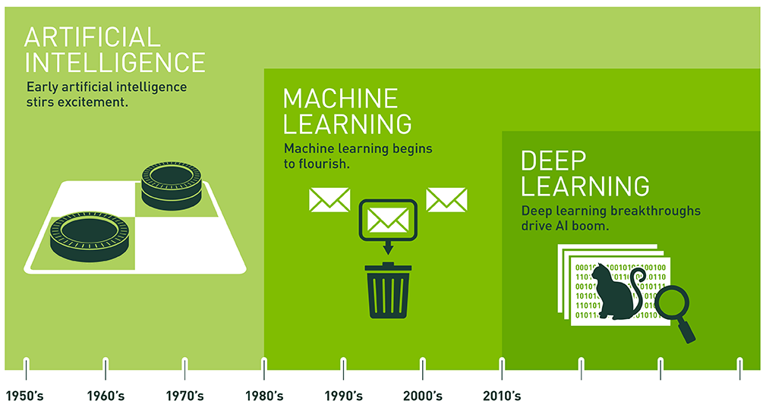
Landscape of AI
A Date with AI

Slide 5
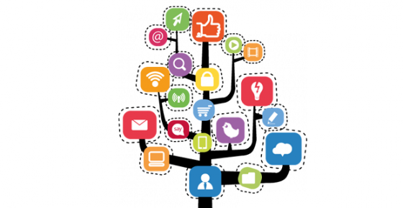
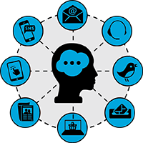
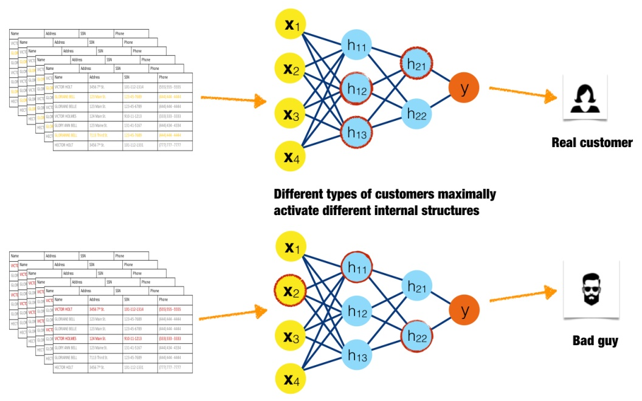
What led to AI boom
Large increase in data volume
Ease of Collection of data
Diversity in data
Powerful computer hardware
Cheap CPUs, Memory and Storage
Specialized hardware GPU/TPU
Graphical Processing Unit
Tensor Processing Unit
Significantly improved algorithms
Deep Learning aka stacked neural networks: It has a lot more freedom to align with the signals hidden in the data than its predecessor algorithms
AI reached profitability, so it is being added to commercial products, so it is becoming part of our everyday life, not just a prototype in a research lab
A Date with AI

Slide 6
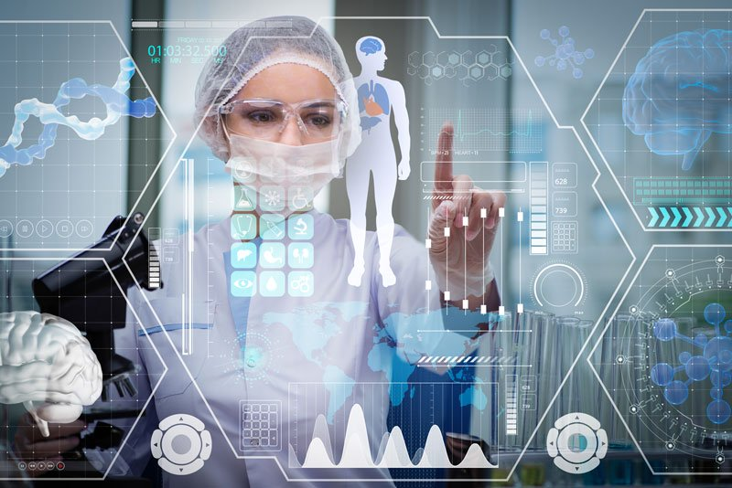
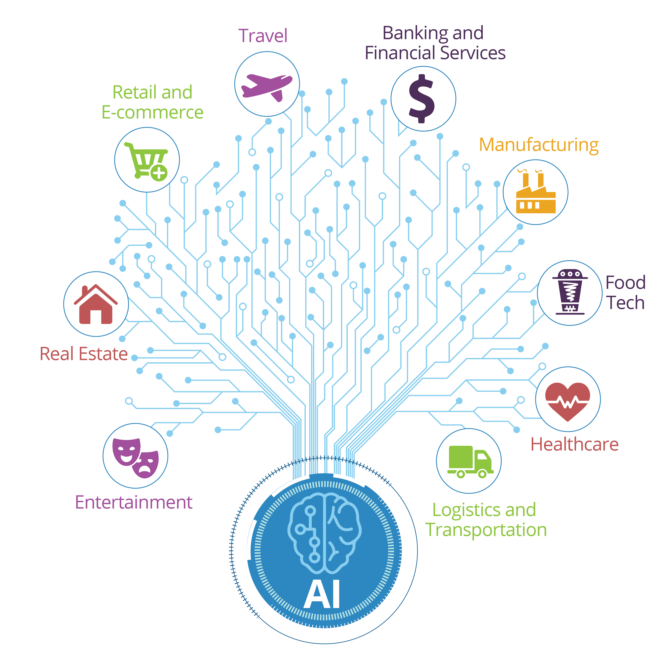
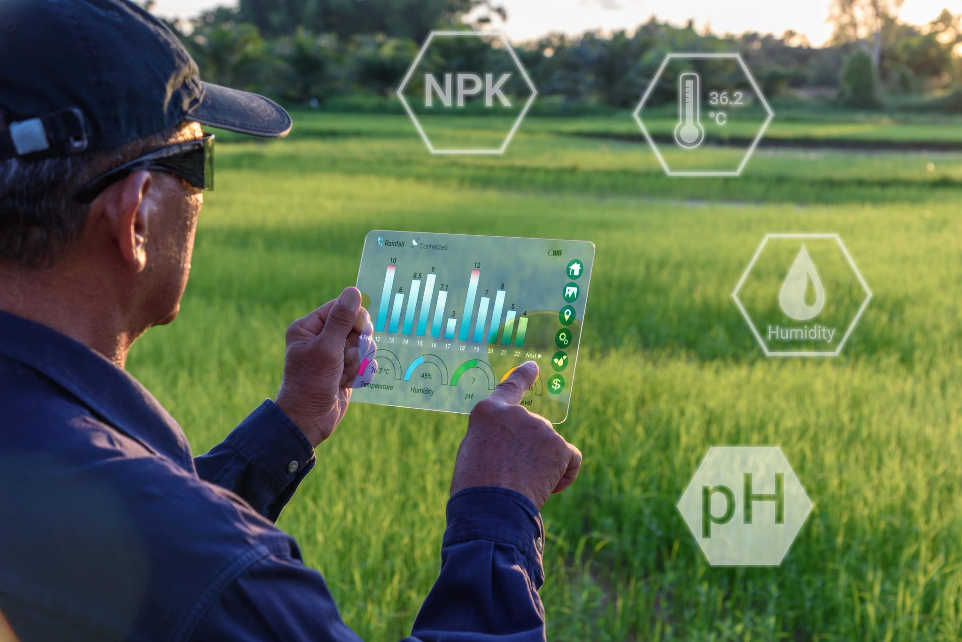
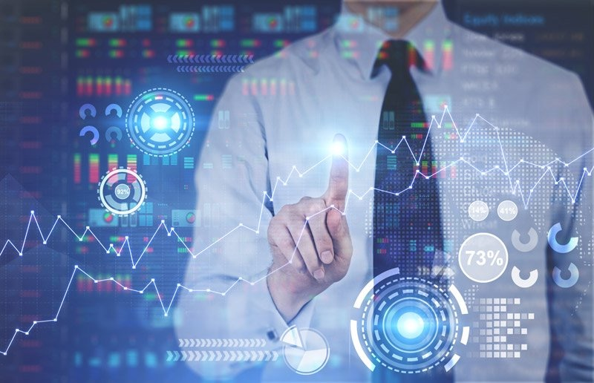
Applications of AI
A Date with AI

Slide 7
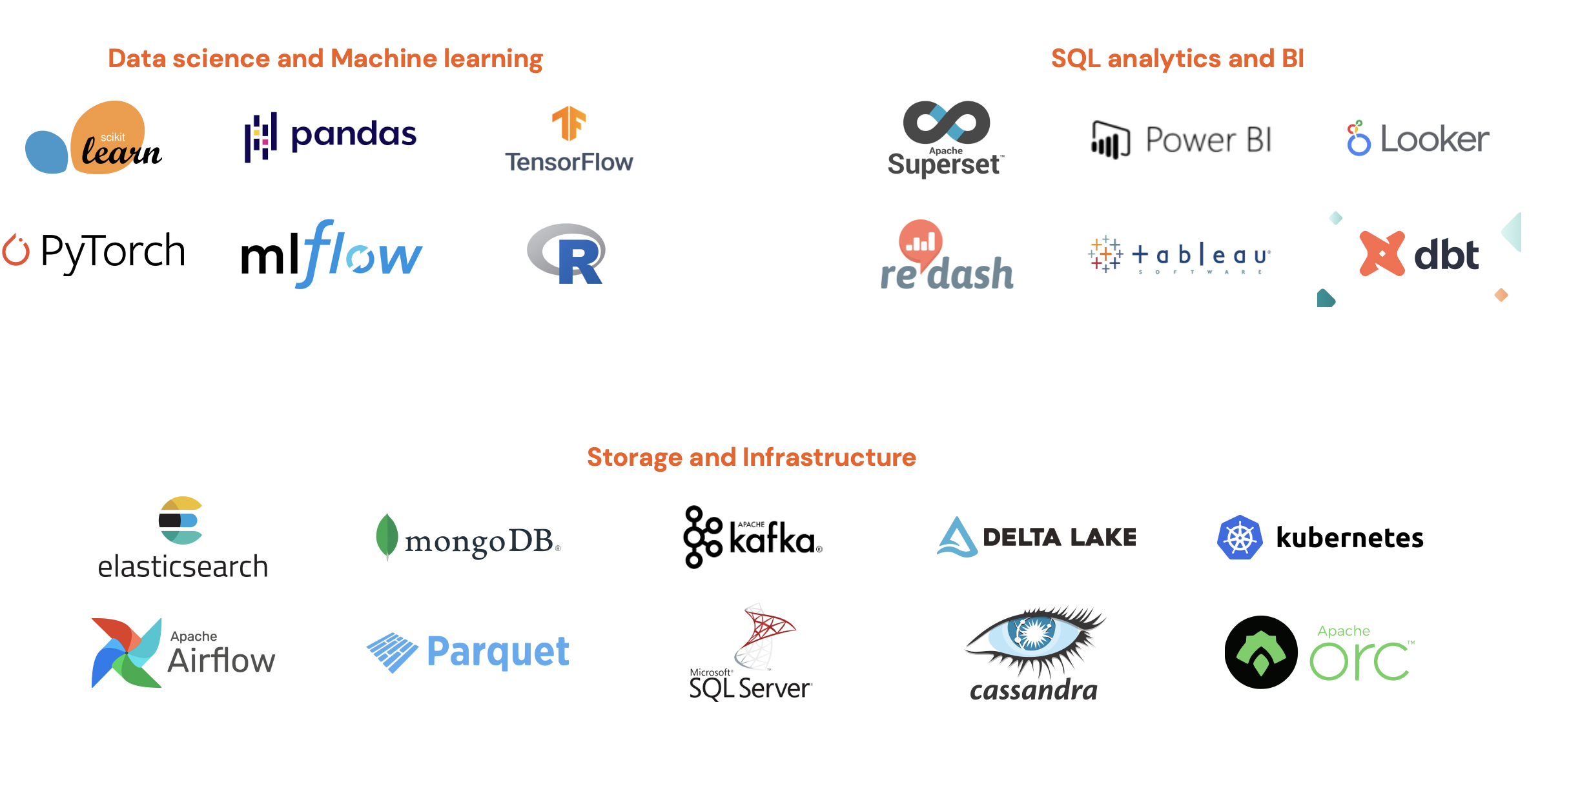
Tools for AI
A Date with AI

Slide 8

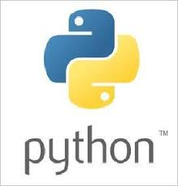




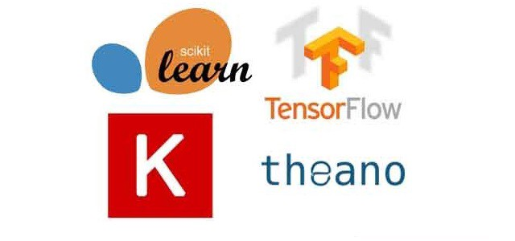


Tools for AI
A Date with AI

Slide 9
How you can Augment your Intelligence

Slide 10
“Books are infinite in number and time is short,
therefore the secret of knowledge is to take what is essential” – Swami Vivekananda
Reading
Watching
Applying
This book is like a story and introduces essential concepts of AI
The Master Algorithm
by Pedro Domingos
Amazon link: https://amzn.to/37EBDA7
”By using concrete examples, minimal theory, and two production-ready Python frameworks—Scikit-Learn and TensorFlow to get started”
Hands-On Machine Learning with Scikit-Learn, Keras and Tensor Flow
by Aurelien Geron
Amazon Link https://amzn.to/34hvuHQ
“If you want to become better at using AI, this is the course to tell everyone--especially your non-technical colleagues--to take”
https://www.coursera.org/learn/ai-for-everyone
Just “Audit this course” for free version
“Inside Kaggle you’ll find all the code & data you need to do your data science work. Use over 19,000 public datasets and 200,000 public notebooks to conquer any analysis in no time”
https://www.kaggle.com
A Date with AI

Slide 11
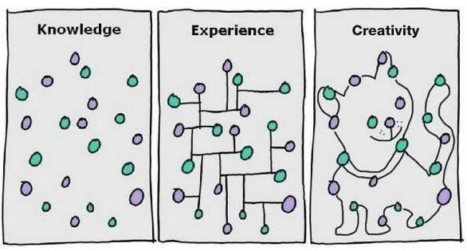
A Date with AI

Slide 12
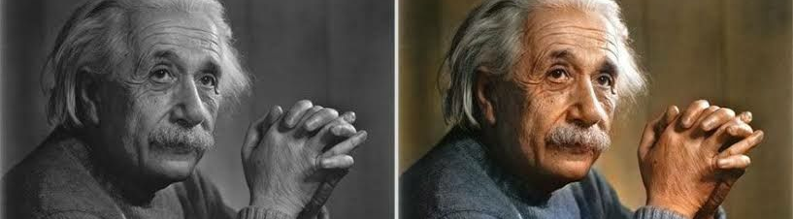
Thank You

